Slide 1
Masterclass
With Rashika Surana
INSTAGRAM
GROWTH
MASTERCLASS
How to start, grow & actually understand Instagram

Slide 2
MY OWN NUMBERS
I've tested this system on my own account first.
20K
7M+
High
Followers
Dashboard Reach
Conversion
Growth from approximately 200 followers.
Growth from 50K professional dashboard
Resulted in a lot of calls booked and real
reach.
business growth.

Slide 3
WHAT ARE WE ACTUALLY
Solving the "beginner's block"
with a 4-step roadmap
DOING TODAY?
1
2
3
4
Basics of
Market
Viral Reels
The Growth
Content
Research
System
Creation

Slide 4
Part 1
NICHE &
POSITIONING
Setting the foundation for your content.

Slide 5
PICK YOUR PLAYING FIELD
Clear Direction
The ultimate goal of your
content
Demand
Market need for your content
Ask yourself these five questions to
find your direction: What do I know?
Audience
What do I enjoy talking about? What
problem can I solve? Who has that
People who will consume your
content
problem? Is there enough demand for
it?
Problem
Issue your content addresses
Enjoyment
Personal satisfaction from
creating content

Slide 6
YOUR POSITIONING FORMULA
Make it stupidly simple.
I help [WHO] achieve [RESULT]
through [WHAT I KNOW / DO].
Example: I help personal brands
WHO
RESULT
HOW
grow on Instagram through
Your audience
What they want
What you help them
content strategy.
with
Clarity beats variety when you're
starting out.

Slide 7
DON'T TRY TO BE KNOWN FOR
EVERYTHING
Your audience should still be able to answer: “Why should I follow this account?”
U might have diverse interests but we gotta pick one and build up !!
Core Territory
Focus
Concentrate on a core
Understand Audience
territory for Instagram
growth.
Expansion

Slide 8

Part 2
UNDERSTAND
YOUR AUDIENCE
Who are you creating for?

Slide 9
Bridging the Audience Gap
Uninformed
Understand
Create
Audience
Audience
Content
Informed
Audience
Lacking knowledge and
Identify needs and
Bridge the gap with
skills
struggles
value
Achieving desired goals

Slide 10
TWO WAYS TO UNDERSTAND YOUR
AUDIENCE
Pros
Cons
Manual vs. AI Research
Manual research involves studying
Deeper insights
AI limitations
reels and content already performing
in your niche. Use AI to map problems,
desires, goals, and fears. Start with
Efficient mapping
Data privacy concerns
observation, then use AI to go deeper.
Data-driven decisions
Over-reliance on AI

Slide 11
01
MANUAL AUDIENCE
RESEARCH
Search your niche
Find content that is clearly performing.
02
03
04
Analyze performance
Create your version
Understand patterns
Look at what people are watching,
Transcribe it, extract the format, add your
commenting about, and what questions or
Understand the patterns and why it is going
inputs, and create your version. Keep the
topics repeatedly get attention.
viral.
format same, bring your own brain.

Slide 12
AI AUDIENCE INTELLIGENCE
Don't know where to start?
Give AI the job.
Prompt: “I create content about
[NICHE] for [TARGET AUDIENCE]. Help
me understand this audience deeply.
Identify their biggest problems,
desires, goals, questions, frustrations,
fears, misconceptions and the things
they actively want to learn about.
Lack of Direction
Organise these insights into clear
Unclear prompts lead to unfocused AI
content opportunities.” Use AI for
Over-reliance on AI
research
research — not for replacing your
AI replaces critical thinking and analysis
brain.

Slide 13
CONTENT
MARKET
RESEARCH
Don't start from a blank screen.

Slide 14
DON'T START FROM A
You're studying the market —
not copying it.
BLANK SCREEN
Build Swipe
File
Establish
Formats
Determine
Topics
Analyze Reels
Identify
Creators

Slide 15
Which audience research method should
you prioritize?
Manual
AI Research
Observation
1
Manually find Reels
1
Identify recurring
already working in
topics, questions,
your niche.
and patterns.
Direct observation of existing
Automated extraction of
successful content.
trends and audience insights.
2
Requires active
2
Leverages
browsing to identify
intelligence to syn-
what is currently
thesize data from
working.
multiple sources.
Relies on subjective human
Focuses on objective pattern
curation and trend spotting.
recognition and deep
analysis.

Slide 16
FOUND A REEL THAT WORKS?
Workflow
Extract the format
Analyze the reel's
Change topic,
and structure
flow
examples,
perspective
Saving Viral
Transcribe It
Understand
Make It Your
Unique Viral
Reels
Structure
Own
Reels
Not making them
Your own brain, your
your own
own reel

Slide 17
Identifying Content Opportunities
Content Analysis
Topic Performance
Hook Effectiveness
Format Success
Content Opportunities

Slide 18
NOW YOU HAVE YOUR CONTENT MAP
No more staring at: “What should I post today?”
Create Your
Content Map
Analyze
Market
Identify
Response
Audience
Understand
Needs
Your Audience
Define Your
Niche

Slide 19
PROFILE
OPTIMISATION
Your Instagram is a digital store.

Slide 20
01
YOUR INSTAGRAM
IS A DIGITAL
STORE
What you do
Within seconds, they should understand what you do and who you help.
02
03
What you talk about
How to work
Within seconds, they should understand what you talk about.
Within seconds, they should understand how they can work with you.

Slide 21
MAKE YOUR PROFILE
SEO
DISCOVERABLE
Content
Name Keywords
Keywords
Keywords in your
Keywords in your posts
username that reflect
that relate to specific
your niche
reels
Bio Keywords
Keywords in your bio
that describe your
content

Slide 22
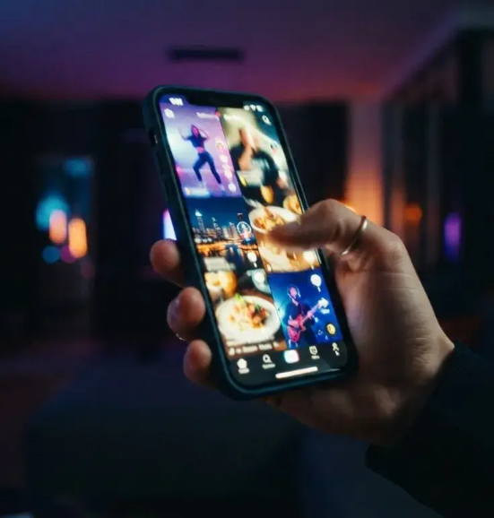
Instagram Growth
Systems &
Scaling
Moving from an optimized profile to a high-
growth content engine.

Slide 23
Instagram Engagement Strategy
Account Reach
The ultimate goal of
engagement
Savable & Shareable
Content
Triggers key engagement
signals
Algorithm's Fuel
Drives content distribution
Views, Likes, Shares,
Saves
Core engagement metrics

Slide 24
Mastering the Hook
Engagement is won in the first 3 seconds and kept throughout the video.
Textual Hooks
Visual Hooks
Use on-screen text to immediately
Incorporate dynamic movement and
convey value and stop scrolling.
transitions to maintain visual
interest.
Creator Prompt
Ask yourself how to add hooks every
3 seconds to keep viewers engaged.

Slide 25
The Distribution Trap
How the "Testing Pool" works and why small accounts often get stuck.
Initial Test
Follower Trap
New Post
Wider
Distribution
Explore/Reels
Interaction
Gate

Slide 26
Unveiling the Power of Trial Reels
Trial Reels
Aspirational
Contrarian
Storytelling
Opinions
Showcasing dreams
Taking a stand against
and the journey to
prevailing opinions.
achieve them.
Pain-Point Driven
Myth Busting
Addressing specific,
Challenging common
frustrating problems for
misconceptions in your
solutions.
niche.

Slide 27
The HVFO Framework
The HVFO Framework: A 4-
step structure to maximize
reach and conversion on
every post.
Optimize
Follow
Value
Hook

Slide 28
Instagram SEO Strategies
Profile SEO
Content SEO
Searchability
Include relevant
Use keywords in
The right keywords
keywords in your
captions, on-screen
increase your
Name field and Bio.
text, and Reel cover
chances of
images.
appearing in search
results for new
audiences.

Slide 29
Lead Magnets & Automation Workflow
The Trigger
DM Automation
The Delivery
The Signal
User comments a
System automatically
Provide guides,
Automation increases
specific keyword on a
sends a direct
checklists, or resources
engagement signals
post.
message.
as lead magnets.
and saves manual
work.

Slide 30
Essential security steps
2FA
Enable 2-Factor Authentication on both
Instagram and Facebook.
Authenticity
Avoid unauthenticated 3rd party tools that
Meta might find suspicious.
Account Status
Regularly check that all four points in your
status are green.
Copyright
Avoid using others' clips without permission
to prevent bans or strikes.

Slide 31
THE ULTIMATE 10K GROWTH ENGINE
ROADMAP
1
4
5
Foundation
Research
Test
The complete, non-stop,
Establish a strong online presence
Gather insights for
Experiment with
improvement
strategies
high-speed cycle of a
professional creator.
9
2
3
6
Win
Content Engine
Scale & Systems
Analyze
The cycle requires executing specific
tactics: Phase 1 includes niche
Achieve growth goals
Create engaging
Expand reach and
Evaluate performance
positioning and SEO; Phase 2 focuses
content
efficiency
metrics
on the HVFO framework and
repurposing; Phase 3 centers on DM
8
7
automation, analytics, and security.
Repeat
Optimize
Continue the cycle for sustained growth
Refine strategies based on analysis

